Slide 1
Normalization

Slide 2
Introduction
ERD is mapped to a relational schema (i.e., a table structure).
Normalization is a systematic process to evaluate and design good table structure to control data redundancy, hence avoiding data anomalies.

Slide 3
Example 1: Products/Vendors Database
Each type of product has a description and a identifying code.
Each product is supplied by zero or more vendors.
Each vendor might offer the product at a different price.
Each vendor has an identifying code, name, and contact information.

Slide 4
Price
V_Contact
V_CODE
P_CODE
P_Descr
Product
Supplies
Vendor
P_Code | P_Descript
P1 | Hammer
P2 | Screw
P3 | Chain
V_Code | V_Contact
V1 | Smith
V2 | Emily
V3 | John
V_Code | P_Code | Price
V1 | P1 | 10.5
V1 | P2 | 11.5
V2 | P1 | 13.5

Slide 5
Alternative ERD for Example 1
Price
P_Descr
V_Contact
P_CODE
Supplied_Products
V_CODE
P_Code | P_Descr | V_Code | V_Contact | Price
P1 | Hammer | V1 | Smith | 10.5
P2 | Screw | V1 | Smith | 11.5
P1 | Hammer | V2 | Emily | 13.5

Slide 6
Is one schema better than the other? Why?
What does it mean for a schema to be good?
The single table schema suffers from the following:
  Redundancy, and as a result:
    Increased storage space
    Anomalies (examples?)
      Update anomaly
      Insertion anomaly
      Deletion anomaly

Slide 7
Is more tables always better?
P_Code
P1
P2
P3
P_Descr
Hammer
Screw
Chain
V_Code
V1
V2
V3
V_Contact
Smith
Emily
John
Price
10.5
11.5
13.5
Information about relationships are lost!

Slide 8
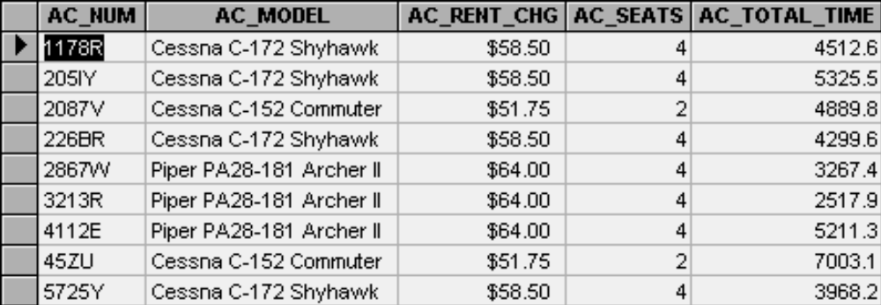
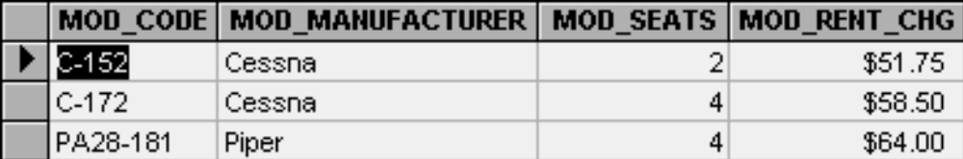
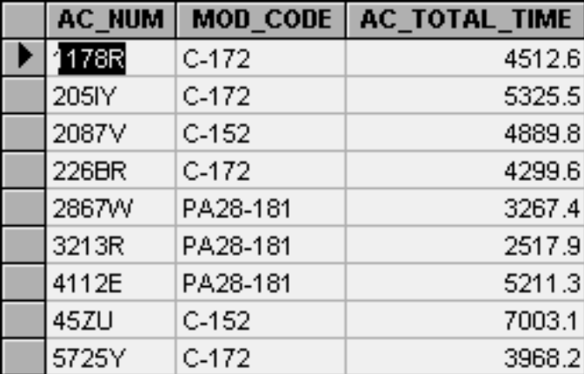
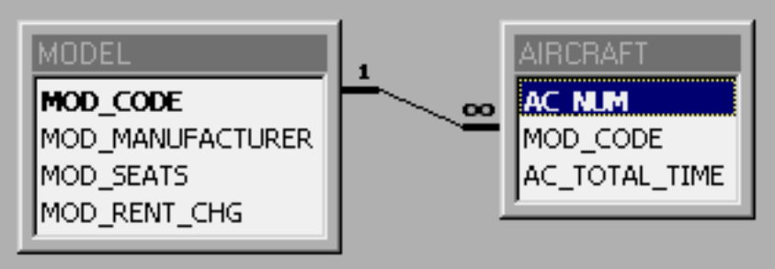
Example 2
AircraftInfo
Design 1:
Design 2:
Model
Aircraft

Slide 9


Slide 10
Designing Good Databases
A methodology for evaluating good schemas:
  Detecting anomalies
  How do we know an anomaly exists?
    functional dependency helps in detecting anomalies
A methodology for transforming bad schemas into good schemas:
  Preventing anomalies
  How do we resolve anomalies?
    Normalizations (or schema decomposition) can prevent anomalies while retaining all information

Slide 11
Functional Dependency
Attribute B is fully functionally dependent on attribute A if each value of A determines one and only one value of B:
  A Determines B
  A➔ B:
    Determinant ➔ Dependent
Concept of determination:
  Attribute A determines attribute B if all the rows in the table that have the same value of A also have the same value for B

Slide 12
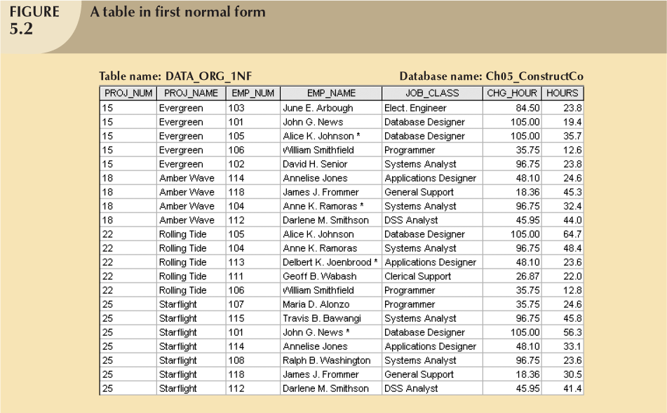
PROJ_NUM ➔ PROJ_NAME
All rows with the same PROJ_NUM have the same PROJ_NAME

Slide 13
Normalization Process
A methodology to refine the database design
Assigns attributes to tables based on the concept of determination
Series of Normal forms:
    First normal form (1NF)
    Second normal form (2NF)
    Third Normal Form (3NF)

Slide 14
Atomicity of Attributes
Domain is atomic if its elements are considered to be indivisible units
  Examples of non-atomic domains:
    Set of names, composite attributes
    Identification numbers like CS101 that can be broken up into parts
Non-atomic values complicate storage and encourage redundant (repeated) storage of data
  Example:
    Set of accounts stored with each customer, and set of owners stored with each account
    Set of employees with each project

Slide 15
Atomicity of Attributes (continued)
Atomicity is actually a property of how the elements of the domain are used.
  Example:
    Strings would normally be considered indivisible
    Suppose that students are given roll numbers which are strings of the form CS0012 or EE1127
      If the first two characters are extracted to find the department, the domain of roll numbers is not atomic.
      Doing so is a bad idea: leads to encoding of information in application program rather than in the database.

Slide 16
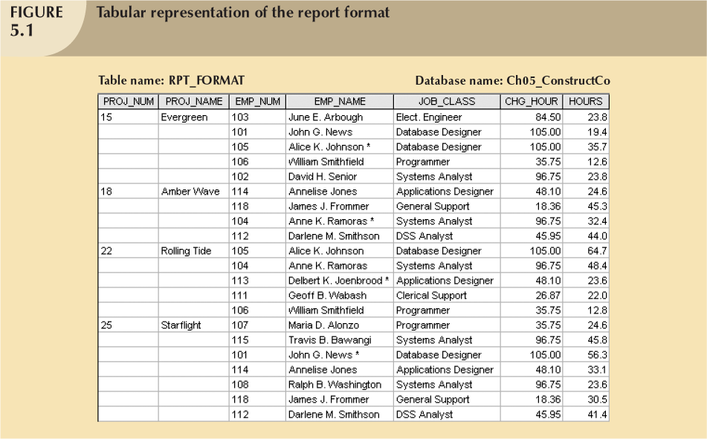
Example 1

Slide 17
Normalization Process
Step 1: Eliminate the repeating groups and non-atomic attributes:
  Example on repeating group:
    The Evergreen project (PROJ_NUM = 15)
      Five related entries
      Every time a new employee is added to the Evergreen project, the number of related entries grows by one
  Eliminate repeating groups:
    Every record in the repeating group is independent

Slide 19
Normalization Process (continued)
Step 2: Identify the primary key:
  Uniquely identify each row in the table
    PROJ_NUM can not be a primary key, why?!!
    PROJ_NUM+EMP_NUM is a composite PK
  PK determines all attributes in the table
  All attributes are functionally dependent on PK

Slide 20
First Normal Form: 1NF
All of the attributes are atomic
There are no repeating groups in the table
  Each row/column intersection contains one and only one value, not a set of values
All attributes are dependent on the primary key

Slide 21
PK: PROJ_NUM+EMP_NUM

Slide 22
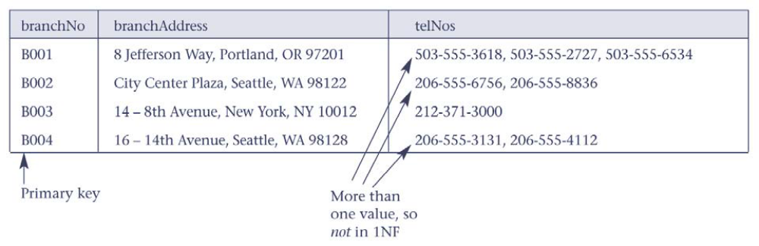
Example 2

Slide 23
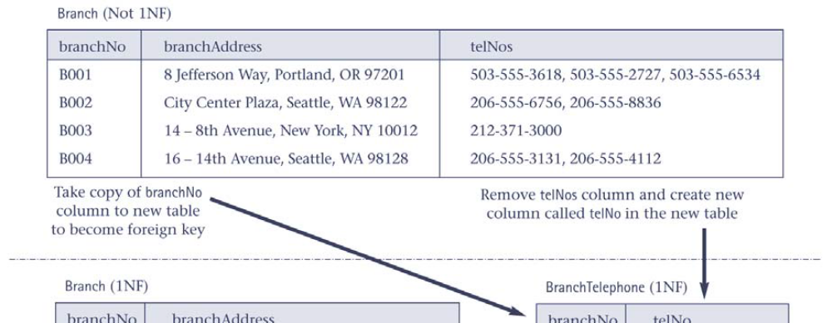
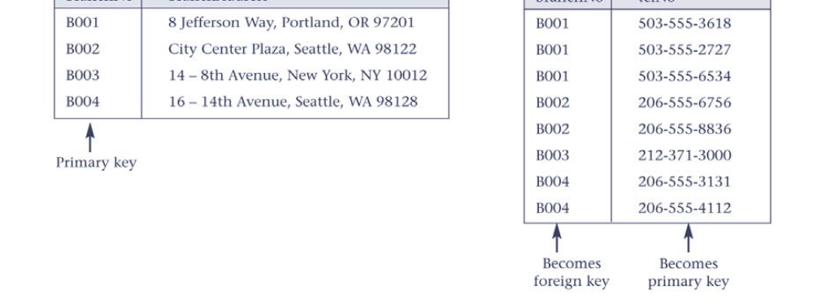
Example 2 Normalization

Slide 24
Normalization Process (continued)
Step 3: Identify all functional dependencies
  PROJ_NUM,EMP_NUM ➔ PROJ_NAME, EMP_NAME, JOB_CLASS, CHG_HOUR, HOURS
  PROJ_NUM ➔ PROJ_NAME
  EMP_NUM ➔ EMP_NAME, JOB_CLASS, CHG_HOUR
  JOB_CLASS ➔ CHG_HOUR

Slide 25
Partial Functional Dependency
An attribute is dependent on only a part of PK
  PROJ_NUM ➔ PROJ_NAME
Exists only if a table has a composite key

Slide 26
Normalizing a table into 2 NF
Eliminate partial functional dependency
Required only if table has a composite primary key
Steps to convert a table to 2NF:
  The original table is divided into three tables
  Assign with each component of PK the attributes that depends on it
    PROJ_NUM ➔ PROJ_NAME
    EMP_NUM ➔ EMP_NAME, JOB_CLASS, CHG_HOUR
    PROJ_NUM,EMP_NUM ➔ ASSIGN_HOURS

Slide 27
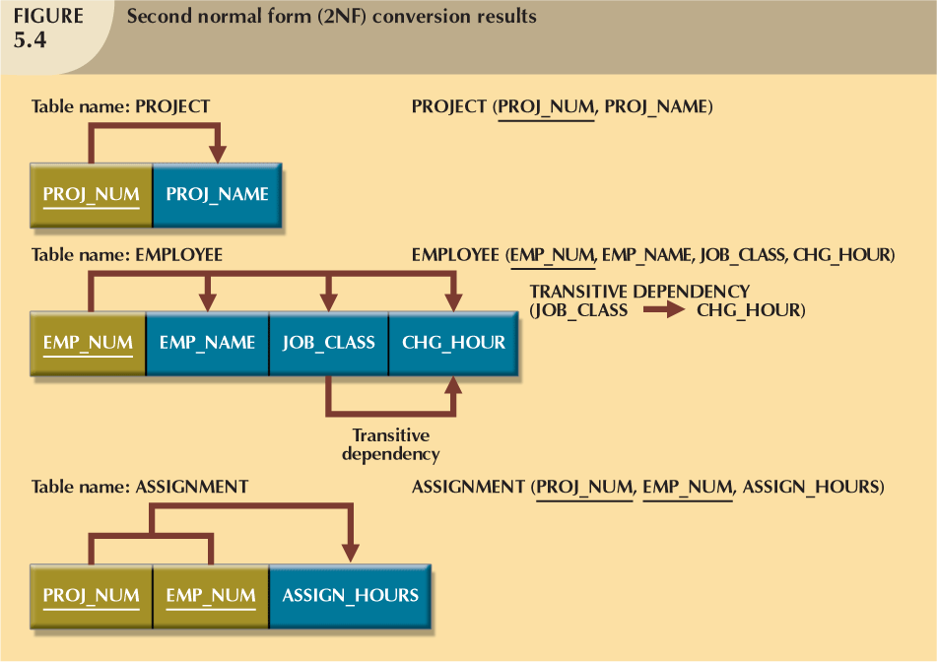

Slide 28
Example 3: Combined course-section tables
What is the PK?
What are the functional dependencies?
What are the insert, update, delete anomalies in the following table!!!!
What if we combine course and section:
CourseID | section | semester | Day | Time | Location | CourseName | instructor | phone
Math115 | 1 | Spg2014 | Mon | 6pm | Mpls18 | College Algebra | Jones | 312-4444
Math115 | 2 | Spg2014 | Tues | 6pm | Found88 | College Algebra | Smith | 818-5050
ICS311 | 1 | Spg2014 | Mon | 6pm | SJH154 | DataBase Mgmnt Systems | Smith | 818-5050
ICS311 | 2 | Spg2014 | Thurs | 6pm | Midw8 | DataBase Mgmnt Systems | staff | 834-9781
Math115 | 1 | Fal2014 | Mon | 6pm | Mid8 | College Algebra | staff | 666-9999

Slide 29
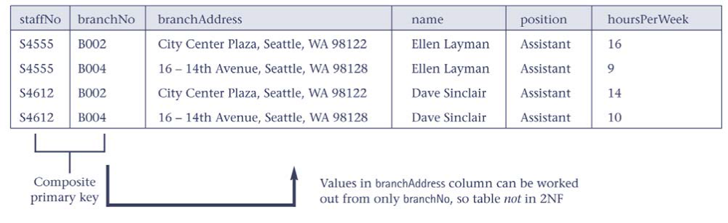
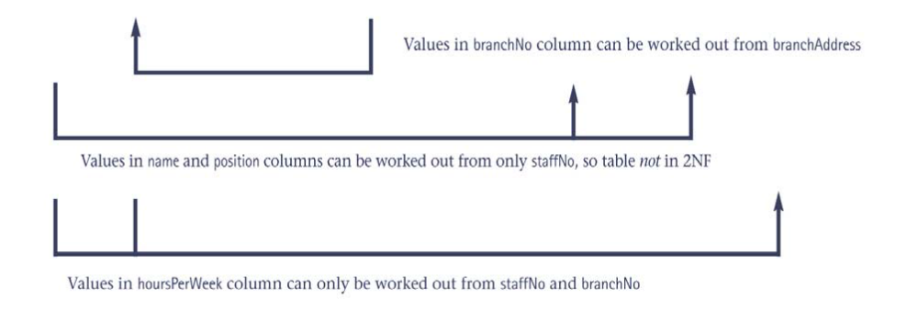
Example 4

Slide 30
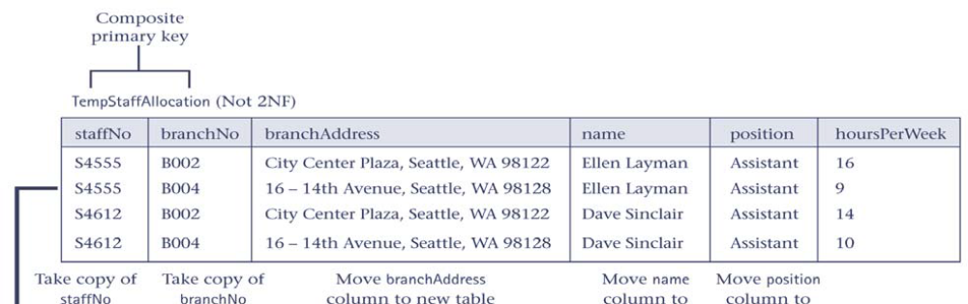
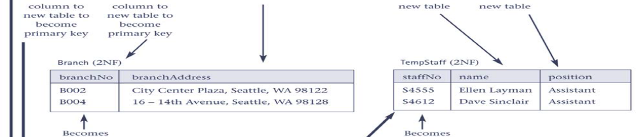
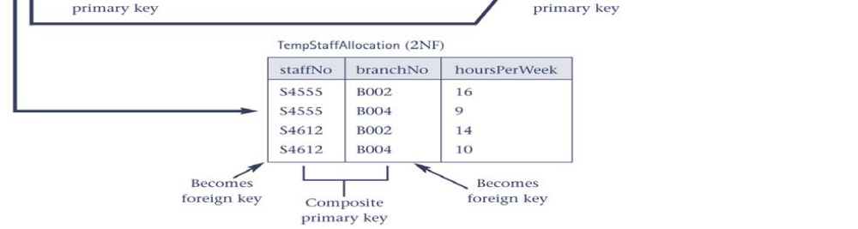
Example 4 Normalization to 2NF

Slide 31
Example 5
StdSSN StdCity StdClass OfferNo OffTerm OffYear courseNo CrsDesc EnrGrade
Primary key is: stdSSN, offerNo
StdSSN ➔ StdCity, Std,Class ➔ Partial functional dependency
OfferNo ➔ offTerm, OffYear, Courseno, CrsDesc ➔ partial functional dependency
CourseNo ➔ CrsDesc
StdSSN, OfferNo ➔ EnrGrade

Slide 32
Transitive Functional Dependency
Transitive dependency:
  A nonprime attribute is dependent on another non-prime attribute
    JOB_CLASS ➔ CHG_HOUR

Slide 33
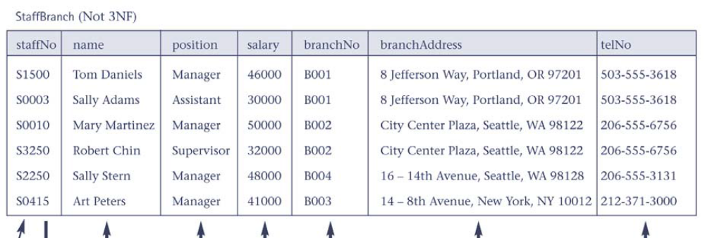
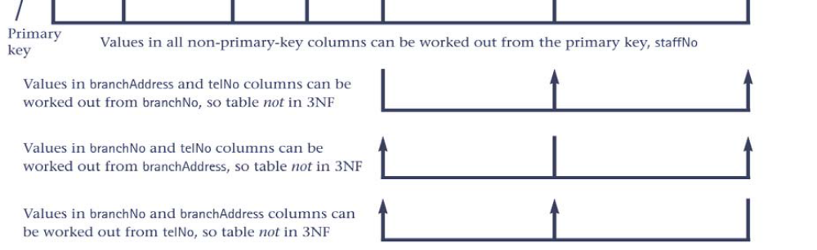
Example 6

Slide 34
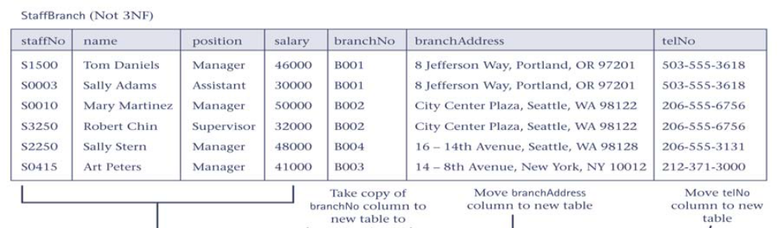
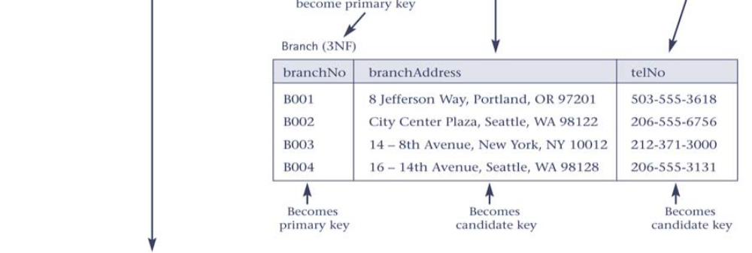
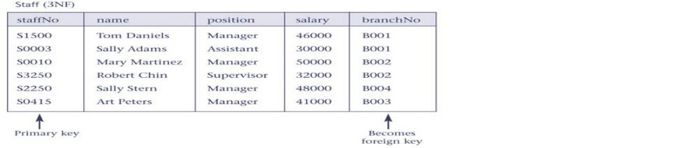
Example 6 Normalization

Slide 35
Third Normal Form
Eliminating transitive dependency
Each transitive dependency is mapped to a table
Steps:
  Determinant attribute is the PK for the new table
  The dependent attributes are moved to the new table
    JOB_CLASS ➔ CHG_HOUR
  Remove the dependent attribute from the original table
  The determinant attribute remains in the original table
    EMP_NUM ➔ EMP_NAME, JOB_CLASS

Slide 36

Example 7: Combined instructor-department table
What is the PK?
What are the functional dependencies? transitive dependency?
What are the insert, update, delete anomalies in the following table!!!!
dept_name ➔ building,budget

Slide 37
Normalization Process
The higher the normal form:
  The less the redundancy
  The less the anomalies
However, the higher the normal form:
  More table decomposition
  More join operations required to produce a specified output
  More resources required from DBMS to answer user queries

Slide 38
Normalization and Database Design
ER diagram
  Identifies relevant entities, their attributes, and their relationships
  Identifies additional entities and attributes
Normalization procedures
  Focus on characteristics of specific entities
Normalization process is attached to ERD modeling process

Slide 39
Normalization and Database Design
Make sure that proposed entities meet required normal form before table structures are created
Many real-world databases have been improperly designed or burdened with anomalies
You may be asked to redesign and modify existing databases

Slide 40
Denormalization
Creation of normalized relations is important database design goal
Performance or query execution time should also be a goal
If tables are decomposed to conform to normalization requirements:
  Number of database tables expands
  More time is needed to join tables

Slide 41
Denormalization (continued)
Joining the larger number of tables reduces system performance
Conflicts often resolved through compromises that may include denormalization:
  Accept a level of redundancy in order to get better performance.
Problems with denormalization:
  Data updates takes more time and resources

Slide 42
Denormalization for Performance
Example:
  Displaying prereqs along with course_id, and title requires join of course with prereq
Alternative 1: Use denormalized relation containing attributes of course as well as prereq with all above attributes
  faster lookup
  extra space and extra execution time for updates
  extra coding work for programmer and possibility of error in extra code
Alternative 2: use a materialized view defined as
course prereq
  Benefits and drawbacks same as above, except no extra coding work for programmer and avoids possible errors

Slide 43
Overall Database Design Process
We have assumed schema R is given
  R could have been generated when converting E-R diagram to a set of tables.
  R could have been a single relation containing all attributes that are of interest (called universal relation).
  Normalization breaks R into smaller relations.
  R could have been the result of some ad hoc design of relations, which we then test/convert to normal form.

Slide 44
ER Model and Normalization
When an E-R diagram is carefully designed, identifying all entities correctly, the tables generated from the E-R diagram should not need further normalization.
However, in a real (imperfect) design, there can be functional dependencies from non-key attributes of an entity to other attributes of the entity
  Example: an employee entity with attributes
  department_name and building,
  and a functional dependency
  department_name→ building
  Good design would have made department an entity

Slide 45
Steps going from conceptual to logical design
Conceptual ERD:
  the version that captures what the user said.
  Include:
    entities (to become tables)
    relationships (to become foreign keys)
  is not implementable as a relational database.
Once the conceptual ER diagram is finished, and approved by the user, the conceptual ER need to be mapped to a Logical ERD
Logical ERD:
  the version that is ready to hand to the data base administrator (DBA) to be turned into real tables.
  can be mapped one-to-one to tables and foreign keys in a relational database.

Slide 46
Steps
1) Add all relevant attributes to each entity
2) replace each M-to-M relationships with an entity. Then, label all relationships: 1-1; 1-M; M-1; M-M. Look one more time at any 1-1 relationships: the two entities probably should be combined, unless there is a very good reason not to.
3) Put all tables into 1st Normal form:
  Break compound attributes into separate attributes (address becomes street, city, state, zip) (name become firstName, middleInitial, lastName)
  Get rid of repeating fields (multiple phone numbers). (Create another table for phone numbers)

Slide 47
Steps (continued)
4) put all tables into 2nd normal form. (Every non-key attribute depends on the whole key)
5) put all tables into 3rd normal form. (Every non-key attribute depends on nothing but the key)
6) Test the structure against representative multi-table SQL queries

Slide 48
Reading
Chapter 5:

